Slide 1
Entity Framework 6
15-Mar-18 | Start
30-Apr-18 | 38
Appendix
Online

Slide 2
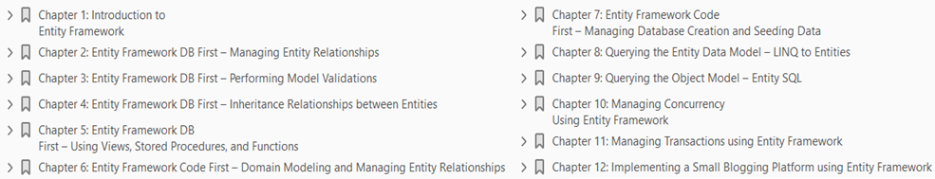
Mastering EF 6
Ch | Date
1 | 30 Apr 18
2
3
4
5
6
7
8
Mastering Entity Framework 6 2015

Slide 3
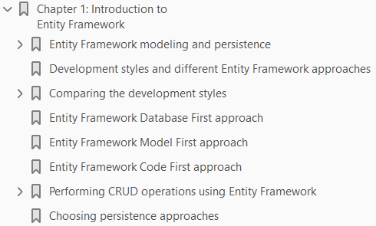
1
Introduction to Entity Framework

Slide 4
Intro
Entity Framework is an Object Relational Mapper (ORM) from Microsoft that lets the application's developers work with relational data as business models.
It eliminates the need for most of the plumbing code that developers write (while using ADO.NET) for data access.
Entity Framework provides a comprehensive, model-based system that makes the creation of a data access layer very easy for the developers by freeing them from writing similar data access code for all the domain models.
The initial release of Entity Framework was Entity Framework 3.5. It was released with .NET Framework 3.5 SP1 and Visual Studio 2008 SP1.
EF eases the task of creating a data access layer (DAL) by enabling the access of data, by representing the data as a conceptual model, that is, a set of entities and relationships.
The application can perform the basic CRUD (create, read, update, and delete) operations and easily manage
one-to-one
one-to-many, and
many-to-many relationships
between the entities.

Slide 5
Benefits of using Entity Framework
Here are a few benefits of using Entity Framework:
The development time is reduced since the developers don't have to write all the ADO.NET plumbing code needed for data access
We can have all the data access logic written in a higher-level language such as C# rather than writing SQL queries and stored procedures
Since the database tables cannot have advanced relationships (inheritance) as the domain entities can, the business model, that is, the conceptual model can be used to suit the application domain using relationships among the entities.
The underlying data store can be replaced relatively easily if we use an ORM since all the data access logic is present in our application instead of the data layer.
If an ORM is not being used, it would be comparatively difficult to do so.
Let's try to visualize the Entity Framework architecture (Figure 1-1):
From the figure, we can see that Entity Framework is written on top of the ADO.NET framework, and underneath, it is still using the ADO.NET methods and classes to perform the data operations.

Slide 6
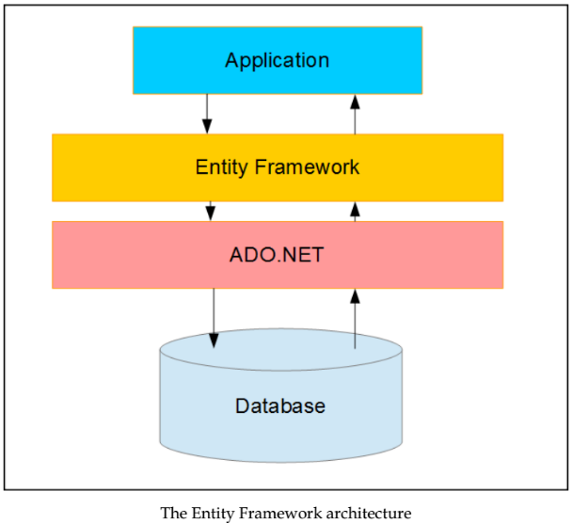
Figure 1-1

Slide 7
Entity Framework modeling and persistence
Entity Framework relies on the conceptual data model for all its working.
Let's understand what the Entity Data Model (EDM) is and how Entity Framework uses it to manage the database operations.

Slide 8
Understanding the Entity Data Model
The conceptual data model is the heart of Entity Framework.
To use Entity Framework, we have to create the conceptual data model, that is, the EDM.
The EDM defines our
conceptual model classes
the relationships between those classes, and
the mapping of those models to the database schema
Once our EDM is created, we can perform all the CRUD operations (create, retrieve, update, and delete) on our conceptual model, and Entity Framework will translate all these object queries to database queries (SQL).
Once these queries are executed, the results will again be converted to conceptual model object instances by Entity Framework.
Entity Framework will use the mapping information stored in the EDM to perform this translation of object queries to SQL queries, and the relational data to conceptual models.
Once our EDM is ready, we can perform the CRUD operations using the model objects. To be able to perform the CRUD operations, we have to use the ObjectContext class.

Slide 9
Understanding the ObjectContext class
Once I have my EDM created, I will have all the entities that I can use in my application.
However, I still need a central arbitrator that will let me perform various operations on these entities.
This arbitrator in Entity Framework is the ObjectContext class.
The ObjectContext class is the main object in Entity Framework. It is the class that is responsible for:
Managing database connection
Providing support to perform CRUD operations
Keeping track of changes in the models so that the models can be updated in the database
The ObjectContext class can be thought of as an orchestrator that will manage all the entities in the EDM, and lets us perform all of the database operations for these entities.
The ObjectContext class has a SaveChanges method that we have to call when we want to save the new or changed objects to the database.

Slide 10
DbContext Class
DbContext is very similar to the ObjectContext class.
In fact, the DbContext class is just a wrapper on top of the ObjectContext class.
It is a rather newer API, and it provides a better API to manage database connections and perform CRUD operations.
Since DbContext is a better API, we will be using DbContext to perform all the database operations.

Slide 11
Development styles and different EF approaches
Before we start looking at the various options to create the EDM, let's talk about the development styles followed by the developers.
Some organizations have separate teams working on the application and the database.
In such cases, the database design is done first and then the application development starts.
Another reason for doing the database design first is when the application being developed is a data centric application itself.
Instead, it might be possible that the application demands the creation of the conceptual domain models first.
Then, based on these conceptual domain models, the database tables will be created, and the application will implement the business logic in terms of these conceptual business models.
Another possibility is that we are creating an application that is highly domain-centric, and the application contains the domain models implemented as classes.
The database is needed only to persist these models with all the relations.
Entity Framework provides support for all these development styles and scenarios.

Slide 12
EF Development Styles
We know that Entity Framework operates on the EDM, and lets us create this EDM in three ways in order to cater to the different development styles:
Database First: This is the approach that will be used with an existing database schema.
In this approach, the EDM will be created from the database schema. This approach is best suited for applications that use an already existing database.
Code First: This is the approach where all the domain models are written in the form of classes. These classes will constitute our EDM. The database schema will be created from these models.
This approach is best suited for applications that are highly domain-centric and will have the domain model classes created first. The database here is needed only as a persistence mechanism for these domain models.
Model First: This approach is very similar to the Code First approach, but in this case, we use a visual EDM designer to design our models.
The database schema and the classes will be generated by this conceptual model. The model will give us the SQL statements needed to create the database, and we can use it to create our database and connect up with our application.
This approach is same as the Code First, but we have the visual EDM designer available.

Slide 13
Comparing the development styles
Before we start looking at these development styles in detail, let's try to do a comparative analysis of these styles. It will help us in understanding these styles in detail.
The Database First approach
The Model First approach
The Code First approach

Slide 14
The Database First approach
In a Database First approach, the main benefit that the developers have is that if the database is created, they will spend very little time writing the data access layer.
The EDM can be created from the database and then we can change it as per our application needs; our data access layer is ready to use.
Here are a few scenarios where the Database First approach is very useful:
When we are working with a legacy database.
When we are working in a scenario where the database design is being done by another team of DBAs, and once the database is ready, the application development starts.
When we are working on a data centric application, that is, the application domain model is the database itself, and it is being changed frequently to cater to new requirements.
For instance, when the tables are being updated regularly and new columns are being added to it frequently then we can simply use this approach, and the application code will not break.
We simply have to write the code to cater to the newly added columns.

Slide 15
The Model First approach
Similar to the Database First approach, in the Model First approach, we ultimately end up with the EDM.
Using this EDM, we can create our conceptual model and the database.
The only reason to choose the Model First approach is that we really want to use the Visual Entity Designer.
There is no other strong reason to choose this approach over the other two.

Slide 16
The Code First approach
The Code First approach is usually helpful where all the business logic is implemented in terms of classes, and the database is simply being used as a persistence mechanism for these models.
Here are a few reasons why one might want to choose the Code First approach:
The database is simply a persistence mechanism for the models, that is, no logic is in the database.
Full control over the code, that is, there is no auto-generated model and context code.
The database will not be changed manually.
The model classes will always change and based on this, the database should change itself.

Slide 17
Entity Framework Database First approach
This approach has been available since the first version of Entity Framework.
In this approach, we start with an already existing database and start creating our EDM from the existing database.
Let's try to see how this works using the Entity Framework Database First approach with our ToDo sample.
To use the Entity Framework Database First approach, we have to add a new ADO.NET EDM to our project, as shown in Figure 1-2.

Slide 18
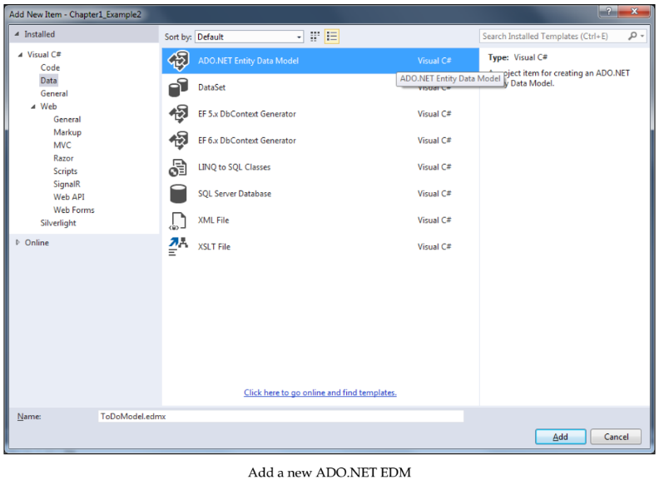
Figure 1-2

Slide 19
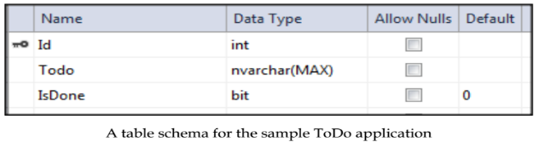
Defining Database
Let's define a database for the ToDo application.
Create a simple table that will keep a track of all the ToDo items:
The application requirements state that it should be possible to perform the following activities on the ToDos:
Read the list of ToDos
Create a ToDo item
Read a specific ToDo item
Update the status of a ToDo item
Delete a ToDo item

Slide 20
Adding EDM
When we add the EDM, it asks us whether we want to create the conceptual model from the existing database, or if we want to create an empty model.
For the Database First approach, we need to select an existing database. The Figure 1-3 shows the wizard step that asks you to select the database.
Once we choose to add the EDM, we need to specify the database that should be used to create it. So, the next step in the wizard will ask you for the connection to the database.
The Figure 1-4 shows the wizard step that asks you to select the database.
Once the connection is successfully established, the wizard shows us all the tables, views, procedures, and functions that we will want to access from our application.
Using this wizard, we can also choose to include the foreign key relations in our conceptual model and singularization of the model name, in case the table name is plural in our conceptual model (Figure 1-5).
Once the conceptual model is created, the EDM will be created for use in our application.
The application will create a .EDMX file that contains all the information about our conceptual entity model and its mapping to the database tables (Figure 1-6)

Slide 21
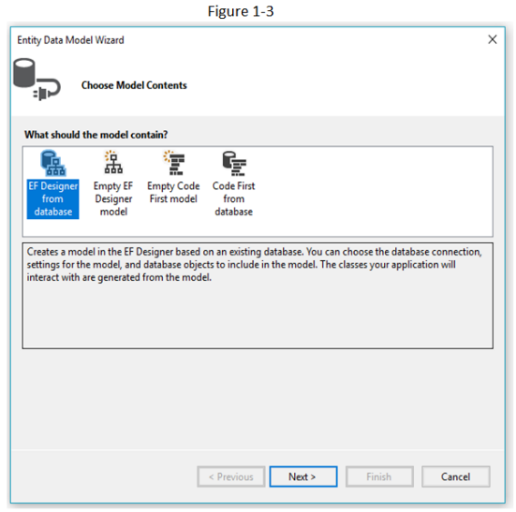
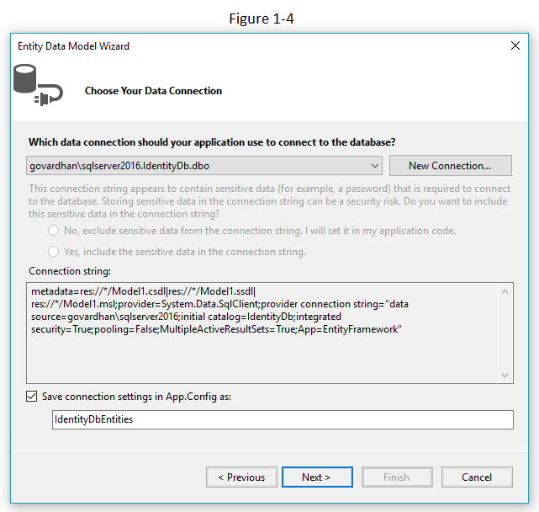
Figure 1-3 || 1-4

Slide 22
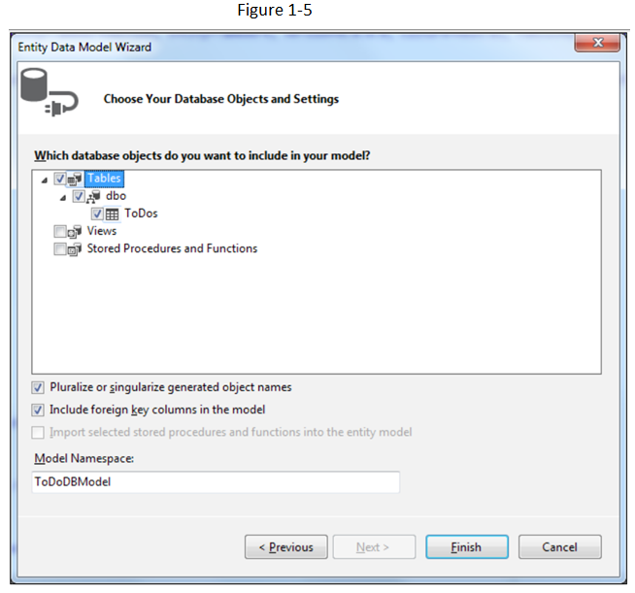
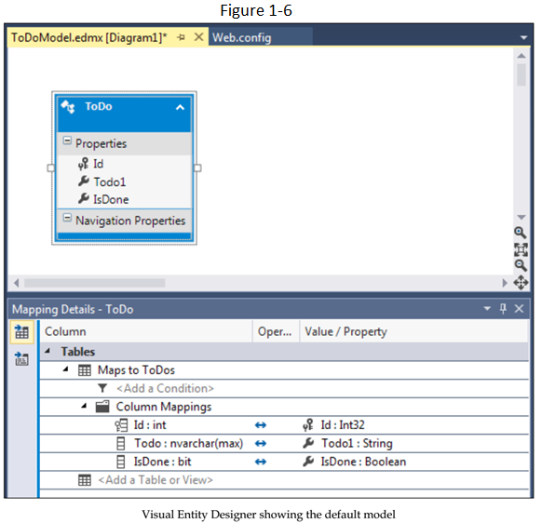
Figure 1-5 || 1-6

Slide 23
Modifying EDM
We can modify the conceptual model and change the mapping using entity designer. Let's try to change the property ToDo1 to ToDoItem in our conceptual model.
Only the class property has been changed, and not the column name (Figure 1-7).

Slide 24
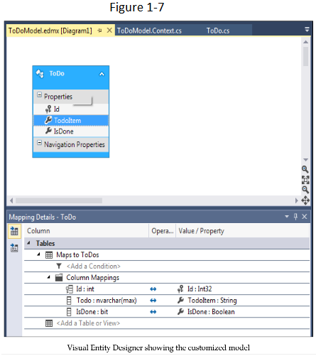
Figure 1-7

Slide 25
EDMX file: Sections
If we open the EDMX file (with XML editor), we can find the following three sections:
Conceptual schema definition: This specifies how a strongly typed model for our conceptual model will be created (Listing 1-1).
Storage schema definition: This specifies how the storage model is created, that is, how the values are stored in the database (Listing 1-2)
Mapping: This specifies the mapping between the conceptual model and the storage model: (Listing 1-3)
We should always prefer to change these values from the Visual Entity Designer.
We can modify this XML manually to change it as per our needs, but Visual Entity Designer allows us to perform most of the modifications, and unless we need to make a change that is not supported by entity designer, we should try not to make them manually.

Slide 26
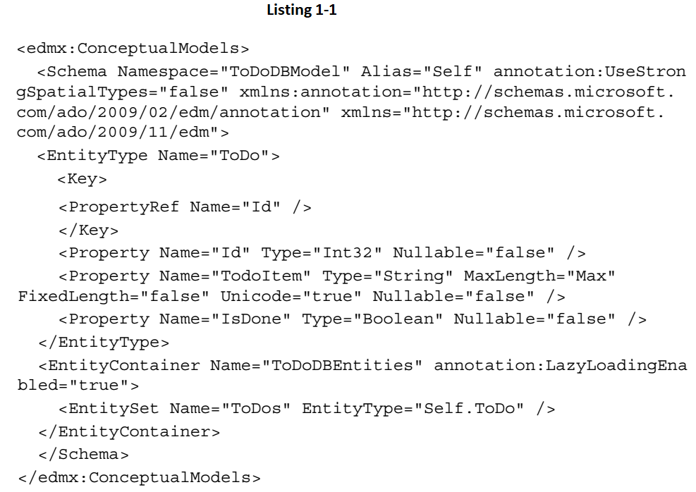
Listing 1-1

Slide 27
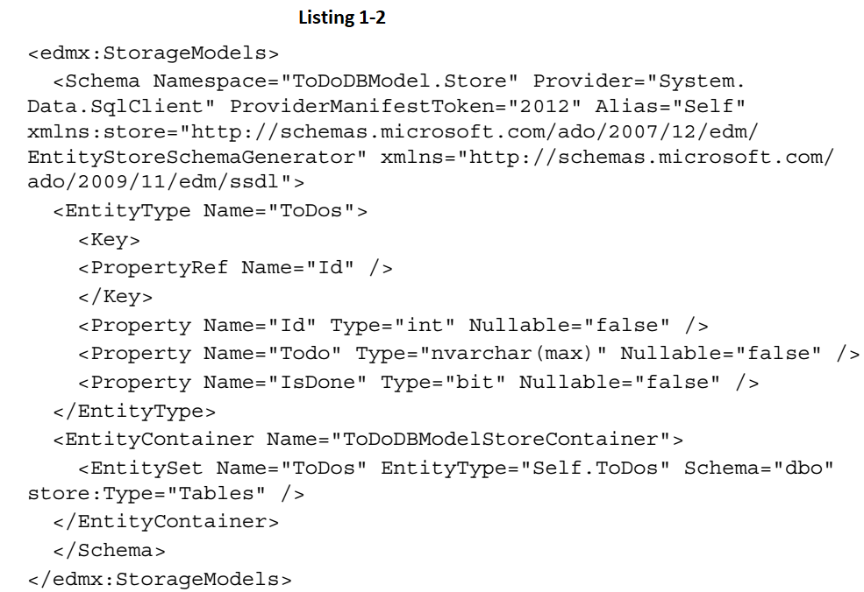
Listing 1-2

Slide 28
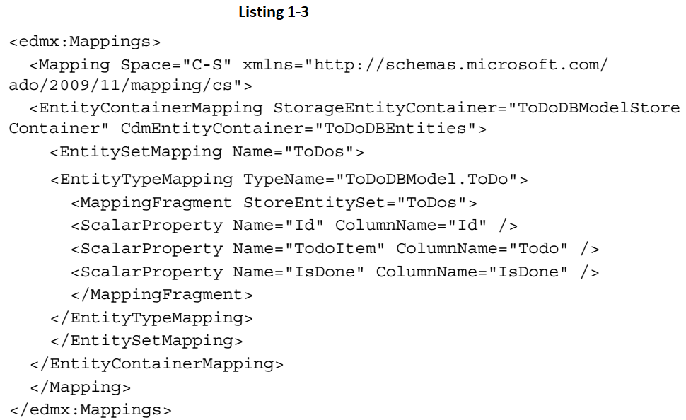
Listing 1-3

Slide 29
DBContext & Model Class
Once the EDM is created, we will get a class generated for each model object present in our conceptual model.
We will also get the DBContext class tat will let's use these strongly typed models (Figure 1-8).
Now we are ready to write typed queries against the generated conceptual model, and Entity Framework will execute our queries on the database, and return the results in the form of these strongly typed models.
Creating new data or updating the existing data is also very easy, because Entity Framework automatically tracks the changes we make in our models, and lets us save the changes to the database.
This can simply be done by calling the SaveChanges method on the DBContext class.
The read operation can utilize Language-Integrated Query (LINQ) to query the object data model, and Entity Framework will take care of converting it to the appropriate SQL query and retrieve the results.
We can have relationships between our domain models and still let them persist the data in a given set of tables.
In the Database First approach, the Entity Model is able to incrementally update the conceptual model if the database schema is updated.
We just need to right-click on the visual designer and chose Update Model from Database.

Slide 30
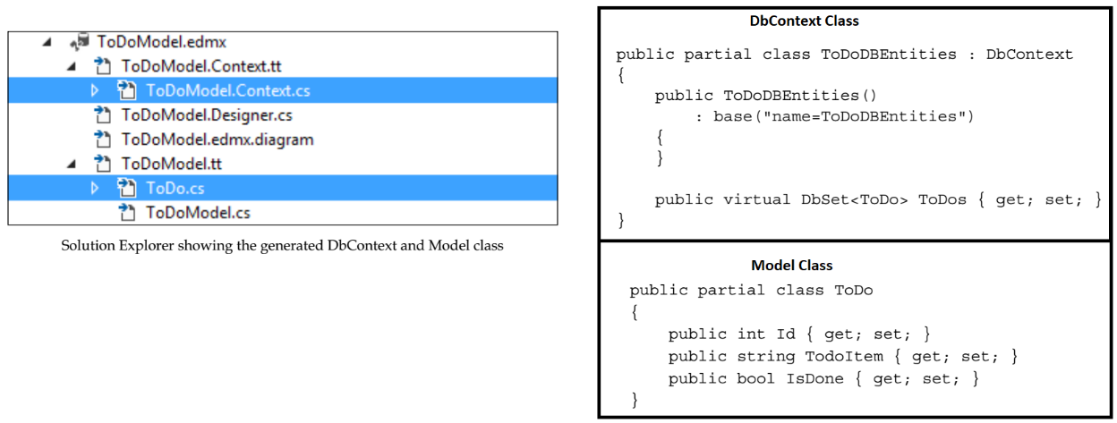
Figure 1-8

Slide 31
Entity Framework Model First approach
The Model First approach is useful when we don't have a database to start with.
Using this approach, we can create our models directly in the Visual Entity Designer, and then create the database schema based on our model.
In this approach too, we can create entities and their properties, define relationships and constraints between the entities, and create inheritance relationships.
In this approach, we will first create the conceptual model, and based on this the database and the strongly typed objects will be created.
To start with the Model First approach, we first need to add an ADO.NET EDM (Figure 1-9).
Since we are planning to start with an empty model, we have to select an empty model in the wizard.
The Figure 1-10 shows the wizard step that asks you to select the option.
We have to select Empty model in this step.
Once we choose the empty model, Entity Framework will show us the Visual Entity Designer.
Now we can add the entities and relations to the designer area from the toolbar.

Slide 32
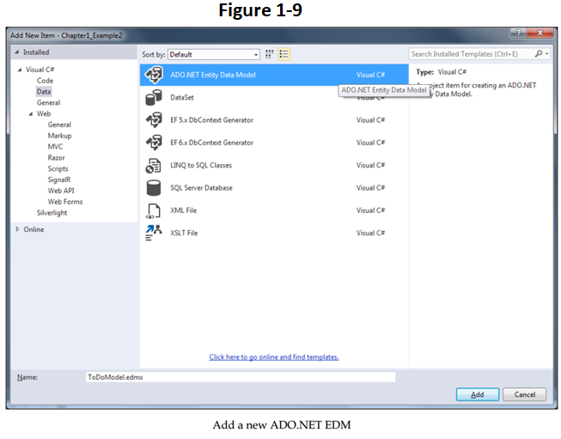
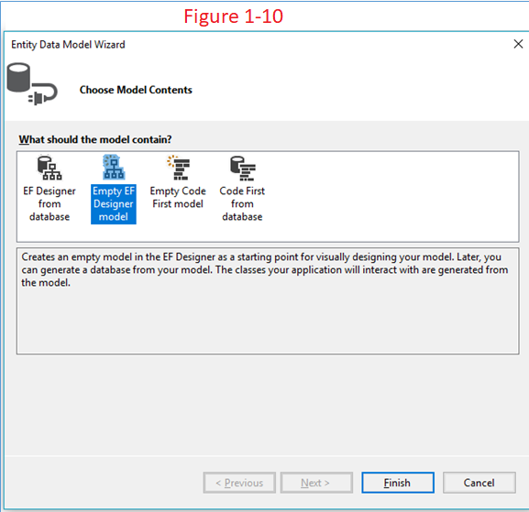
Figure 1-9 || 1-10

Slide 33
Entity Designer
The Entity Designer and the toolbar is as shown in Figure 1-10A.
Let's try to add a new entity to our ToDo application and add properties to that model.
Let's add a few properties to our ToDo model - Figure 1-10B.
Let's add the scalar properties needed for our ToDo model. Let's make the ID field a primary key field, a string property for ToDoItem, and a Boolean property for IsDone - Figure 1-10C.
The created entity will look something like this - Figure 1-10D.
Once we have the conceptual model created for our application, we have to create the database from this conceptual model.
This can be done by right-clicking on the entity and choosing Generate Database from Model.
This will prompt you to select the database connection. This wizard will not create the actual database, but it will generate the DDL for us, and we will have to use that DDL to create the database ourselves.
After we select the database connection, the wizard will give us the SQL to create the database on the specified connection.

Slide 34
Entity Designer |
We can now copy this SQL and create the database.
The Entity Framework has already created connectionString to use this connection, and wired up the DBContext class to perform the operations on this database.
Let's take a look at the generated DbContext class: Figure 1-10E
The strongly typed objects will also be generated from the conceptual model. Let's take a look at our generated ToDo class Figure 1-10F.
If we are using the Model First approach, one important thing to consider is that the incremental changes in our model will not perform the incremental updates to the database.
Rather, it will give us the SQL to create the updated database from the ground up.

Slide 35
NOTE
If we want to perform incremental updates to the database, we can use the Database Generation Power Pack from Microsoft (https://visualstudiogallery.msdn.microsoft.com/ df3541c3-d833-4b65-b942-989e7ec74c87/).
Using this, we can perform incremental updates to the database.

Slide 36
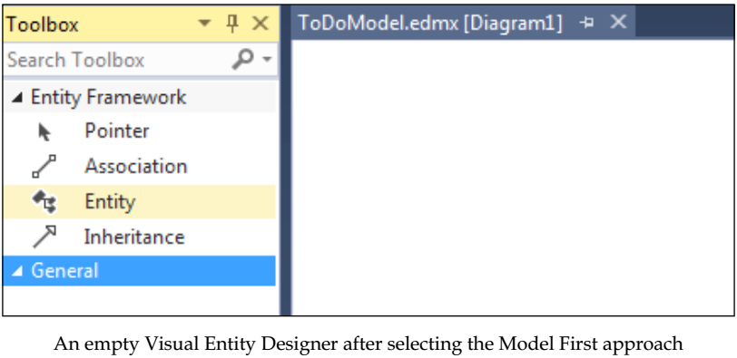
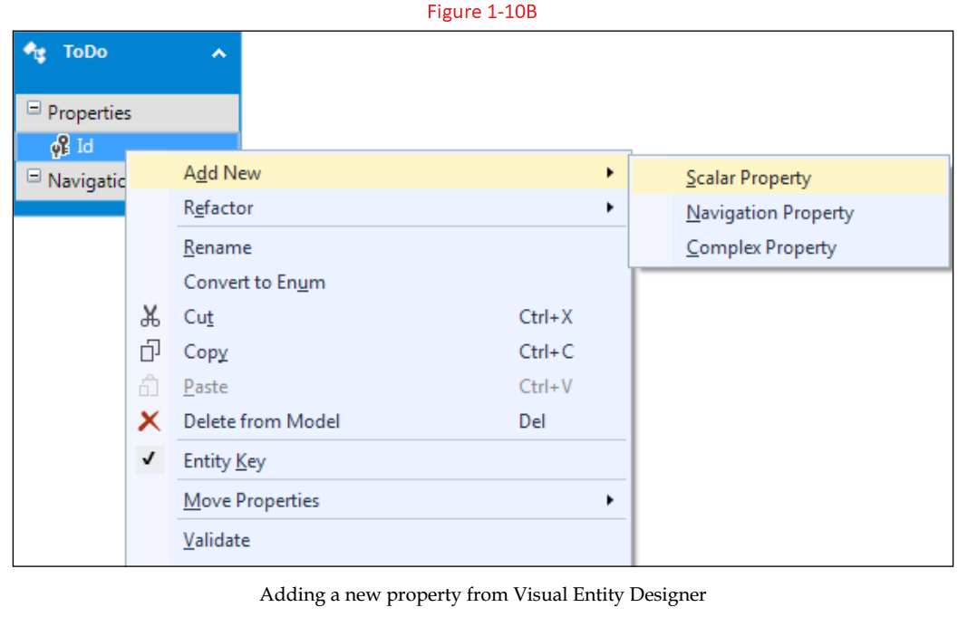
Figure 1-10A || 1-10B

Slide 37
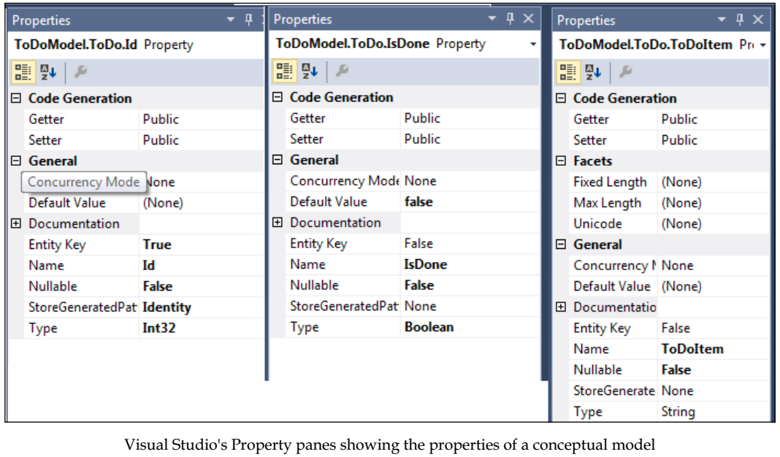
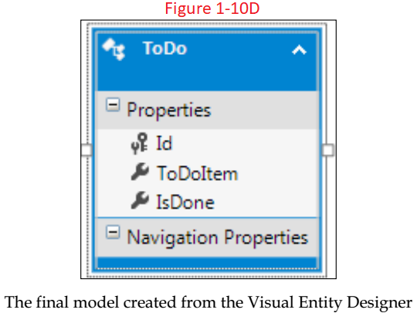
Figure 1-10C || 1-10D

Slide 38
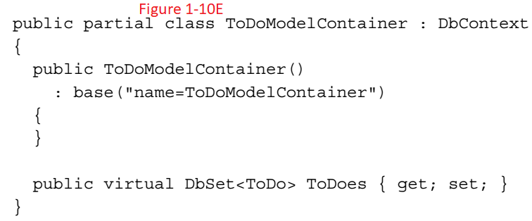
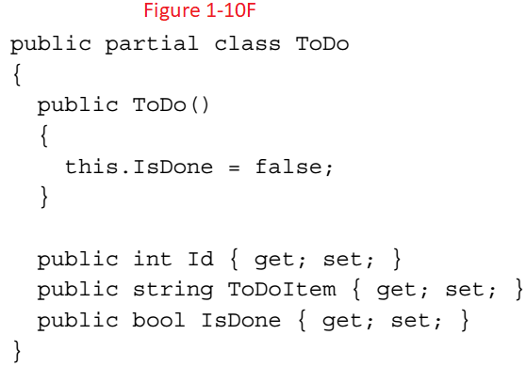
Figure 1-10E || 1-10F

Slide 39
Entity Framework Code First approach
Now, let's take a look at the Entity Framework Code First approach.
In this approach, we will start by creating the model classes ourselves.
We will then implement our business logic against these classes, and then if we need to persist these models, we can use the Entity Framework Code First framework to save these models to the database.
Thus, the Entity Framework Code First approach enables us to write simple C# classes, that is, Plain Old CLR Objects (POCOs) for our models, and then lets us persist them in a data store by defining a DbContext class for our model classes.
So, if we want to implement our ToDo application using the Code First approach, we will first have to create the ToDo model ourselves. Let's create a simple ToDo class that will keep track of our ToDo items Code 1-1.
Once we have the ToDo class ready, we need to start thinking about how the database will be created from our classes.
We need to tell Entity Framework how to use our classes and generate the database accordingly.
We want to tell the database generation module about all the persistence information, such as table names, key columns, and so on.

Slide 40
Entity Framework Code First approach |
In the preceding code, we updated our class with a table attribute passing in the table name.
This will tell the Entity Framework that a table should be created for this class.
Each property of the class can be updated with the Column attribute, and we can specify the name of the column this property should be mapped to and the data type.
The Key attribute will be used to specify the property that should be used as a primary key.

Slide 41
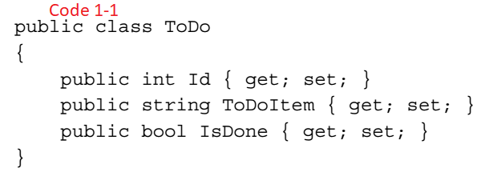
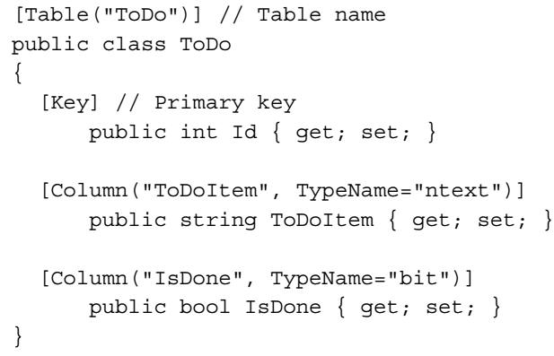
Code 1-1 || 1-2

Slide 42
DbContext class
Entity Framework uses the DBContext class to save the models to the database.
In the Code First approach, we need to create the DBContext class ourselves too.
Let's see how we can implement our DBContext class: Code 1-3.
The context class that we are creating should be derived from the DbContext class.
The context class will also keep DbSet of ToDos that will represent the list of ToDo items being retrieved from the table.
The constructor of the context class will pass the name of connectionString to the base DbContext class.
This connectionString will be used to connect to the database.
Another possibility is to keep the name of the connectionString the same as the DbContext class name. The Entity Framework will be able to use the corresponding DbContext class with this connectionString to persist the data.
This is an example of the Convention over configurations principle.
However, this is also flexible, so that we have the possibility of giving custom names to the connectionStrings.
Now to be able to use Entity Framework to persist the data, we just need to create this connectionString in the XML configuration, and Entity Framework will take care of creating the database and performing the CRUD operations on their respective models.

Slide 43
DbContext class |
This has shown you how to use the Code First approach using a single model.
In later chapters, you will see how to use multiple models and have relationships between them, how we can define complex types, and customize models as per our application requirements.
We have looked at how Entity Framework supports various development approaches and lets us create the conceptual model and data access logic very easily.
We have seen that Entity Framework depends on the EDM to perform the database CRUD operations, and we have also looked at the various ways to create the conceptual model and map it to the database using the Database First, Model First, and Code First approaches.
To fully understand the benefits of Entity Framework over ADO.NET, we must also look at how easy and efficient it is to use Entity Framework to perform the actual operations.
This will also show how performing CRUD operations is the same, irrespective of the approach we take.
Let's now see how we can perform CRUD operations using Entity Framework to fully understand the benefits of Entity Framework.

Slide 44
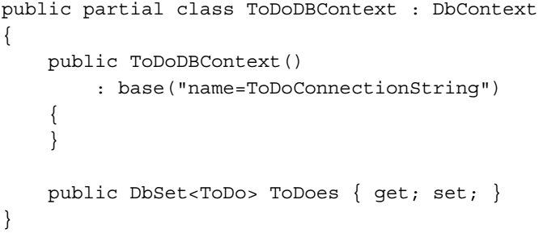
Code 1-3

Slide 45
Performing CRUD operations using EF
We will perform CRUD operations on our ToDo model using the Entity Framework DbContext class.
Now let's say we have a model for our ToDo item, that is, ToDo. We also have the DbContext class created to perform CRUD operations on the ToDo model.
Let's take a look at how we can use Entity Framework to perform CRUD operations on our ToDo model.
The important thing to note in these examples would be the use of LINQ.
We will write all our queries in LINQ, and Entity Framework will take care of converting it to the appropriate SQL and return the results.

Slide 46
NOTE
It doesn't matter which approach we select to create the database and conceptual model (Database First, Code First, or Model First); from the code perspective, it's the same code that the developers need to write in order to use Entity Framework.

Slide 47
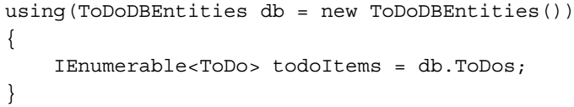
Reading a list of items
The way Entity Framework works is that using the DbContext class, we can retrieve all the data by simply accessing the model collection associated with the view.
So, to fetch a list of items, we just need to get the model collection from the context class:
Let's try to understand the preceding code:
We created an object of the DbContext class:
We then used the DbContext object to fetch the ToDo entities:

Slide 48
Reading a list of items |
After this call, the list of ToDo items will be available in the ToDo items collection if we enumerate ToDo items.
Entity Framework will internally perform the following activities for us to fetch the result:
Parsed our request for the data.
Generated the needed SQL query to perform this action.
Used the context class to wire up the SQL to the database.
Fetched the results from the database.
Created the strongly typed models from the retrieved results and return them to the user.

Slide 49
NOTE
If we need to perform eager loading, we can do this by calling ToList( ) on the collection as:

Slide 50
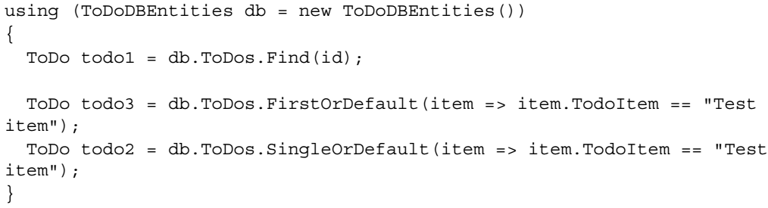
Reading a specific item
If we want to retrieve a single item from the model collection, we have many ways of doing it.
Typically, we can use any LINQ function to fetch the single record from the model collection.
Also, if we want to fetch the result using the primary key, we can use the Find method to do it.
Let's look at a few ways in which we can retrieve a single item using Entity Framework:
Let's try to understand the preceding code:
We created an object of the DbContext class:

Slide 51
Reading a specific item |
Retrieved an item by passing the key values, that is, using the Find function:
Retrieved an item by passing a non-key value using the FirstOrDefault function:
Retrieved an item by passing a non-key value using the SingleOrDefault function:

Slide 52
NOTE
The FirstOrDefault and SingleOrDefault functions will return the first occurrence of the item if it is found, else it will return null.
We should always check for the null values before using the item retrieved using these functions.
SingleOrDefault will throw an exception if it finds multiple items matching the request criteria.

Slide 53
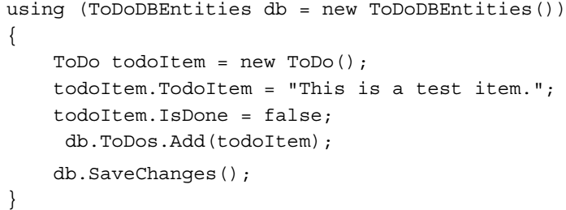
Creating a new item
To create an item, we simply need to create the model, assign the values in the model properties, and then call the SaveChanges method on Entity Framework.
Now let's see how we can create a ToDo item using Entity Framework:
Let's try to understand the preceding code:
We created an object of the DbContext class:
Created a new ToDo item:
Populated the ToDo item properties with the desired values:
Added the item to the context class:
Called Entity Framework's SaveChanges method to persist these changes in the database:

Slide 54
NOTE
Entity Framework's DbContext class is able to identify a new model and generate the respective insert query for it to create a new record on the database.

Slide 55
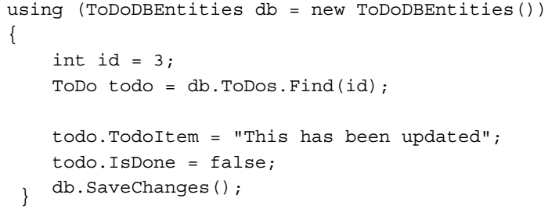
Updating an existing item
To update an existing item, there are two possibilities.
The first possibility is that we will fetch the model, update some of the properties of the model, and then save the updated model in the database.
To do this, we just need to fetch the required model using the DbContext class, update its properties, and then call the SaveChanges method on the DbContext object.
Let's try to update a model with the ID 3:
Let's try to understand the preceding code:
We created an object of the DbContext class:
Fetched the item with id = 3:

Slide 56
Updating an existing item |
Updated the model properties:
Called Entity Framework's SaveChanges method to persist these changes in the database:
What is happening in the preceding code is that the DbContext class was still in scope when the entity was being updated and saved.
The DbContext class is able to track the changes in the entity if it is in scope.
However, this approach is rarely useful, because in real applications in a typical n-tier application, the entities will be passed through multiple layers, and any layer can update this entity, and at the time of updating the entity, objects are usually disconnected from the context.

Slide 57
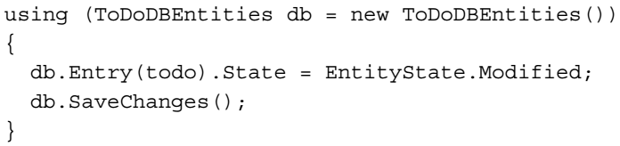
Updating in a Disconnected Environment
So to perform the updates in such a disconnected environment, we need to attach the updated entity back to let the DbContext class identify the modifications made in the entity, and then generate the appropriate update SQL accordingly and persist the updates in the database.
This can be done by attaching the entity back to the DbContext class.
Let's see how a ToDo model can be attached to the DbContext class if it is being passed from a different tier:
Let's try to understand the preceding code:
We created an object of the DbContext class:
Attached the model to the DbContext class and marked this model as modified:

Slide 58
Updating in a Disconnected Environment |
Called Entity Framework's SaveChanges method to persist these changes in the database:

Slide 59
NOTE
In the preceding code, the ToDo model is being modified and passed from some other layer.
This is a fairly advanced topic and if it is not clear at this stage, please move on; this will be covered in detail in further chapters.

Slide 60
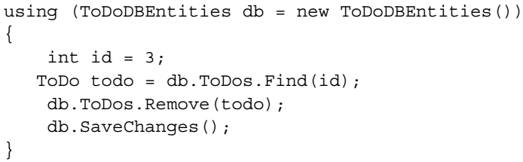
Deleting an item
To delete an item, we just need to fetch the item that needs to be deleted, call the Remove method on the model collection, and call the SaveChanges method on the DbContext class.
Let's try to delete a model with the ID 3:
Let's try to understand the preceding code:
We created an object of the DbContext class:
Fetched the item with id = 3:
Removed the item from the collection:
Called Entity Framework's SaveChanges method to persist these changes in the database:

Slide 61
NOTE
It is also possible that the model entities are getting created and deleted while being disconnected from the DbContext class.
In these cases, we need to attach the models to the DBContext class, and mark them using the EntityState property.

Slide 62
Choosing persistence approaches
Now, we saw the three options to create the EDM and the DbContext class.
Which approach should be used in which scenario, is often a question that many developers ask.
There is no definite reason for choosing any particular approach, but here is a small checklist that the developers might find very useful while deciding on which approach to choose.
If at any point, the answer to any question is yes, then that approach should be used without even looking at the next question in the Checklist A1.

Slide 63
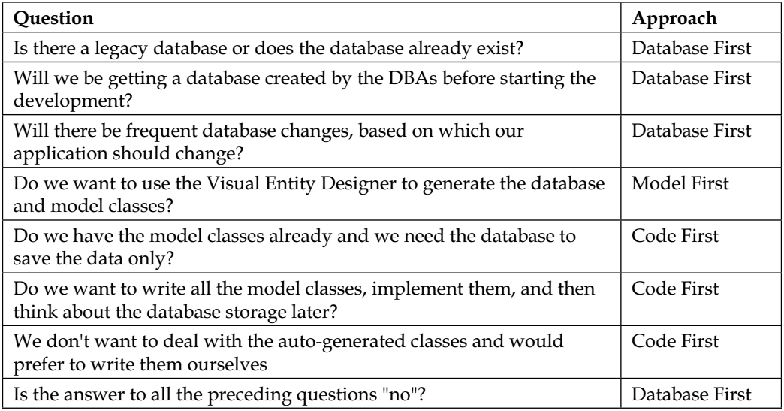
Checklist A1

Slide 64
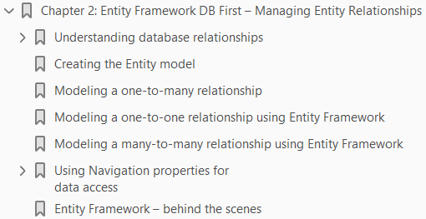
2
Entity Framework DB First – Managing Entity Relationships

Slide 65
Intro
In this chapter, we will see how to model relationships between tables in our Entity Data Model and use Entity Framework to work with these related entities.
We will look at the types of relationship between the tables, and then we will see how this can be modeled in our Entity Data Model.
We will then see how we can perform CRUD operations by utilizing these relationships.

Slide 66
Understanding database relationships
As the complexity of the application grows and the need to store data increases, the number of tables also increases.
If we are trying to store a complex related set of data, then these tables will also relate to each other using foreign keys.
To model our database correctly and have a properly normalized database, we will end up with a set of related tables.
There are three types of relationship that can exist between tables:
One-to-many relationship
One-to-one relationship
Many-to-many relationship
Let's try to understand these relationships from a real-world perspective.
We will then see how these relationships are realized in the database.

Slide 67
One-to-many relationship
This type of relationship is needed when a row from one table is related to many rows in another table.
One typical example of this is the employer-employee relationship.
One organization has many employees, that is, for each row in the Employers table, there will be many rows in the Employees table.
Alternatively, every employee in the Employees table will these belong to only one employer in the Employers table.
It means that an Employer can have 0…* Employees but that an Employee has to be attached to an Employer.
To implement a one-to-many relationship, we have to create a foreign key in the table that is on the many end, Employees in our case.
This will refer to the Employers table's primary key. The primary key of the table at the one end of relationship, that is, the Employers table will have a unique constraint.
Let's try to visualize this relationship by looking at the database schema created for it (Figure 2-1).

Slide 68
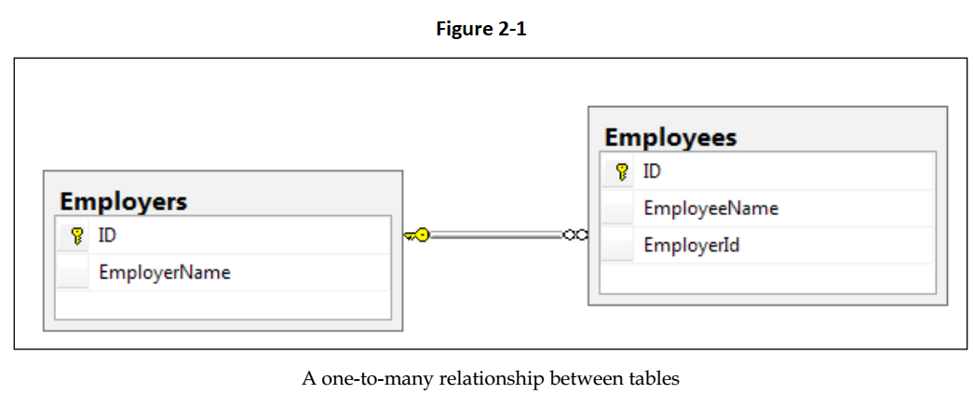
Figure 2-1

Slide 69
One-to-one relationship
This is not a very common scenario, but it is possible.
In this scenario, a row from one table will be related to only one row in another table. Employees and Passports are examples of this.
One employee can have only one passport. So, every row in the Employees table will be related to a single row in the Passports table.
One way to implement a one-to-one relationship in the database is to have a foreign key in the related table, that is, the Passports table in our case.
These foreign key columns will have a unique constraint to ensure that for every passport, there is only one relation to the Employees table.
Unfortunately, the Entity Framework does not support this way of creating a one-to-one relationship.
There is another way to create a one-to-one relationship and that is by making both the tables involved in the relationship share a primary key.
So, if we create a one-to-one relationship by creating both the Passports table and the Employees table share a primary key, then our schema will look like (Figure 2-2).

Slide 70
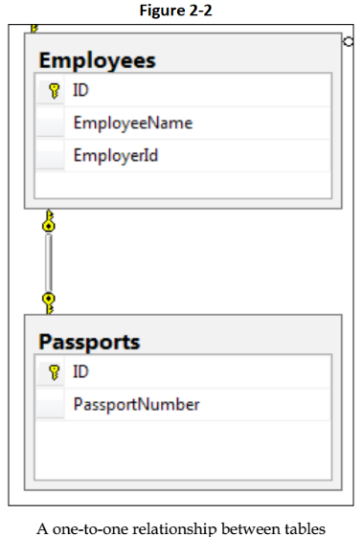
Figure 2-2

Slide 71
Many-to-many relationship
This is a very common scenario where one row from a table could be related to many rows of another table and vice versa.
An example of this type of relationship could be the EmployeeReports relationship.
One report can be written by many employees and alternatively, an employee may have written many reports.
To implement a many-to-many relationship, we need to create a third table.
This table is often called a join table or a junction table.
The primary keys of this table consist of the foreign keys from both the tables involved in the relationship.
Let's try to visualize this relationship by looking at the database schema created for it in Figure 2-3.
In the screenshot, both the tables involved in the relationship are mapped as one-to-many with our join table, which would effectively give us a many-to-many relationship between these two tables.

Slide 72
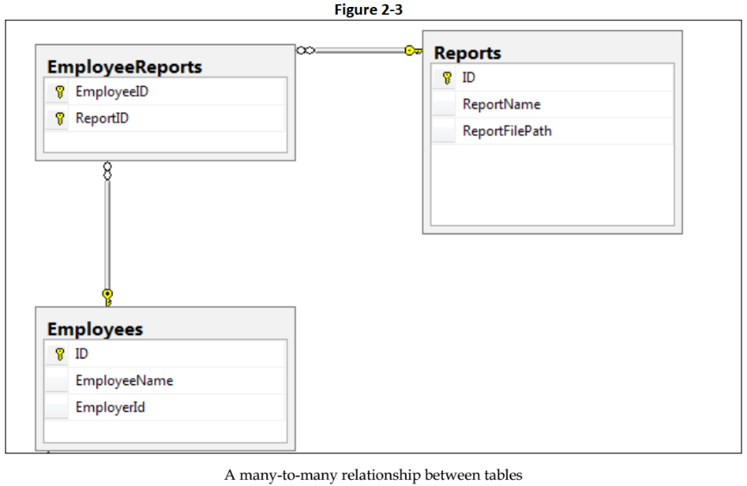
Figure 2-3

Slide 73
Creating the Entity model
Once we have all the relationships created in the database, the complete database will look like Figure 2-4
Now, let's add a new ADO.NET EDM in our application, and then, using this existing database, we will create the Entity Data Model, that is, the conceptual model for our application (Figure 2-5).
We will now start looking at how these relationships are modeled in the conceptual model and how we can use them to perform operations on related entities.

Slide 74
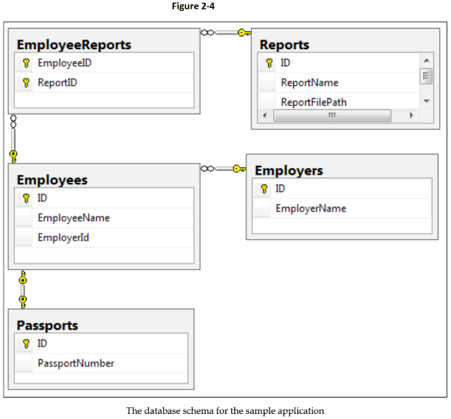
Figure 2-4

Slide 75
NOTE
We will be using this database to create a sample application to understand how to model all the relationships using Entity Framework.

Slide 76
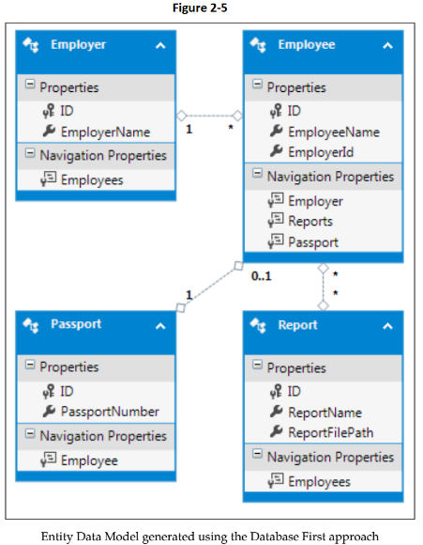
Figure 2-5

Slide 77
Modeling a one-to-many relationship
If we look at the Employer and Employee relation (Figure 2-6), we can see that the Entity Frameworks Entity Data Model generator was able to figure out the one-to-many relationship between the database tables and was able to create the same relationship in the conceptual Entity Data Model as well.
The relationship in the EDM is represented by 1 with the entity at the one end of the relationship and by * with the entity on the many end of the relationship.
If we look at our Entity Data Model, we can see that the Entity Framework created Navigation Properties in the entities.
The entity at the one end of the relationship will have a navigation property of the collection type to hold multiple entities on the many end.
Similarly, the Entity on the many end of the relation will have a navigation property that will let us access the entity related to it on the one end.
In our current example, the Employer model contains a navigation property, Employees, using which we can retrieve/update the list of employees associated with Employer.
The Employee model also contains a navigation property, Employer, using which we can retrieve/update the Employer information for a given Employee.

Slide 78
Modeling a one-to-many relationship |
If we look at the EDMX XML markup (Figure 2-7), we can see that the SSDL contains the information about the one-to-many relationship between the tables.
The same relationship is also mentioned in the CSDL to indicate the one-to-many relationship between the entities.
The MSL in this case will simply contain the mapping information of both the tables involved in the relationship to respective database columns.

Slide 79
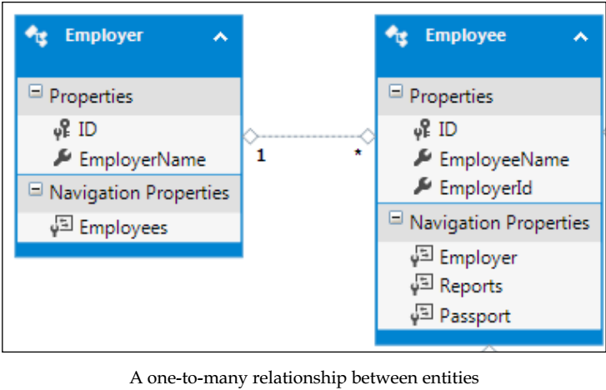
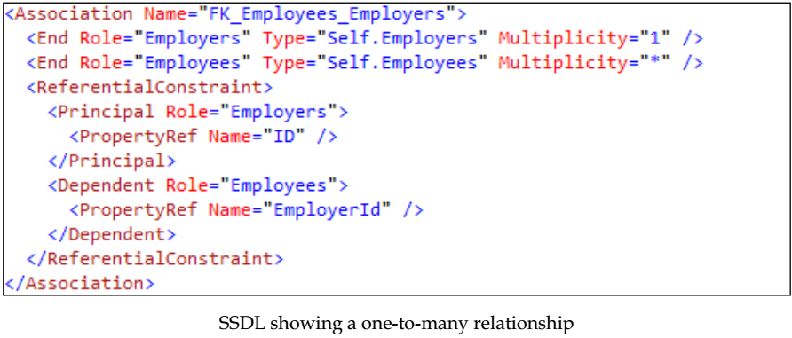
Figure 2-6 || 2-7

Slide 80
Modeling a one-to-one relationship using EF
Now, let's look at the models that have one-to-one relationships.
The Employees table and Passports table has a one-to-one relationship.
If we look at the Employee and Passport relationship (Figure 2-8), we can see that the Entity Framework Entity Data Model generator was able to figure out the one-to-one relationship between these tables and was able to create the same relationship in the conceptual Entity Data Model as well.
Also, one-to-one relationships in the Entity Data Model are represented by 1 with the Employee entity, because this is the main entity in the relation.
The Passport entity shows 0..1, which means that there could be either 0 or 1 entries in the Passport table for each employee.
Entity Framework also created Navigation Properties in the entities. Navigation properties are properties that link the entities to related entities.
Using navigation properties, we can access the entities related to a given entity.
The Employee model contains a navigation property, Passport, using which we can access the related Passport entity and similarly, the Passport model contains a navigation property, Employee, using which we can access the Employee object related to Passport.

Slide 81
Modeling a one-to-one relationship using EF |
If we look at the EDMX XML markup, we can see that the SSDL contains the information about this one-to-one relationship between the tables.
The same relationship is also mentioned in the CSDL (Figure 2-9) to indicate the one-to-one relationship between these entities.
MSL in this case will simply contain the mapping information of both the tables involved in the relationship to the respective database columns.

Slide 82
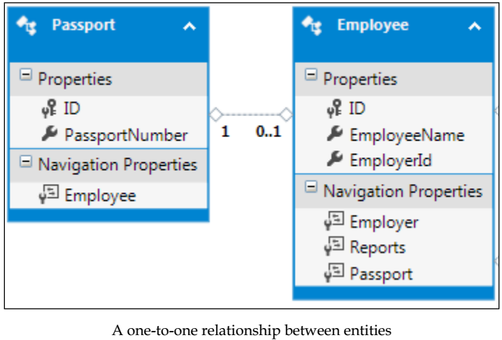
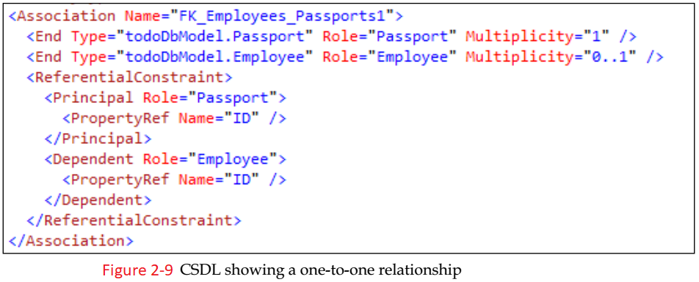
Figure 2-8 || 2-9

Slide 83
Modeling many-to-many relationship using EF
Now, let's look at the models that have many-to-many relationships.
The Employees table and the Reports table have a many-to-many relationship.
If we look at the Employer and Report relationship (Figure 2-10), we can see that the Entity Framework Entity Data Model generator was able to figure out this many-to-many relationship between these tables and was able to create the same relationship in the conceptual Entity Data Model as well.
The important thing to notice here is that the Entity Framework was also able to understand that the EmployeeReports table was created solely to manage a many-to-many relationship, and is actually not needed in the conceptual model.
Also, the relationship in the Entity Data Model is represented by * with both the entities to denote a many-to-many relationship.
Entity Framework also created Navigation Properties in the entities. The Employee model contains a Navigation property, Reports, using which we can access the related records from the Reports table and similarly, the Report model contains a navigation property, Employees, using which we can access Employee records related to Reports.

Slide 84
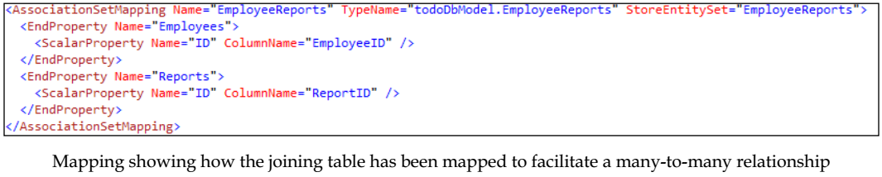
Modeling many-to-many relationship using EF |
If we look at the EDMX XML markup (Figure 2-11), we can see that the SSDL contains information about this many-to-many relationship between the tables.
The same relationship is also mentioned in the CSDL to indicate the many-to-many relationship between these entities.
Now, as the Entity Framework is not showing the joining table and is able to create navigation properties directly in the entities participating in the many-to-many relationship, the mapping part of the EDMX contains information about the joining table that is responsible for facilitating this many-to-many relationship.
This is done by defining AssociationSet in the mapping as follows:

Slide 85
NOTE
Entity Framework is able to figure out this many-to-many relationship and omit the joining table when the joining table has only PK columns for both tables.
Not having the joining table as a separate entity is actually beneficial as the entities will then have direct navigation properties to the related entities, thus eliminating the need for us to navigate to the related entity ourselves.
If we have other columns in the joining table, then Entity Framework will not be able to figure out this many-to-many relationship, and it will create all the entities as normal entities.
In such a scenario, we have to manually join the entities in our object query to achieve the desired results and fetch the appropriate data.

Slide 86
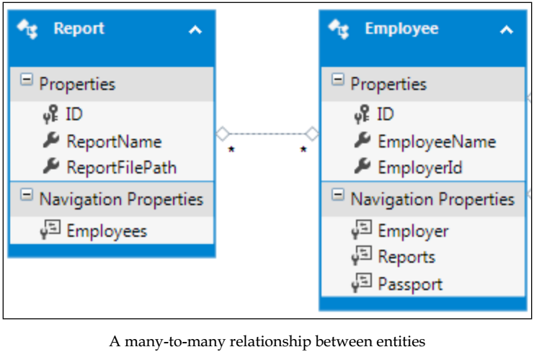
Figure 2-10

Slide 87
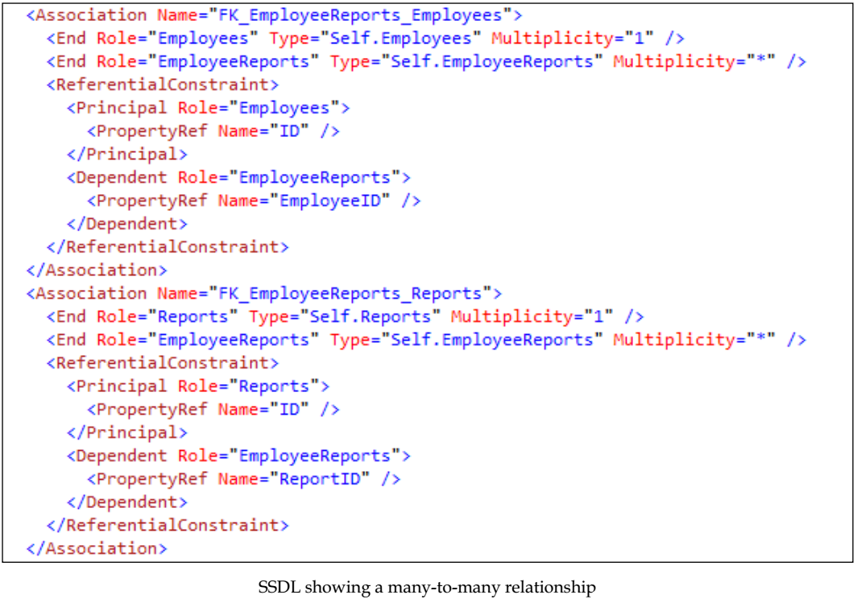
Figure 2-11

Slide 88
Using navigation properties for data access
We have just discussed that the Entity Framework creates navigation properties to facilitate the data access operations on related entities.
Let's now look at how we can use these navigation properties to perform CRUD operations on related entities.
We will only be working with entities involved in one-to-many relationships, that is, the Employer and Employee entity.
However, using navigation properties to perform CRUD operation is more or less similar for all relationships.

Slide 89
Retrieving a specific item
If we have the entity at the many end of the application and we want to retrieve the entity at the one end, we can use the navigation property to do this.
From our sample application's perspective, we will see how we can retrieve the employer for a given employee.
This can be achieved by using the Employer navigation property, available in the Employer object.
Let's see how this can be done in code: Listing R1.
In the preceding code, we create a DbContext object, and using this context object, fetch the Employee by the given employeeId.
If we find an Employee object for this, we retrieve the Employer object associated with it.
We do this by using the navigation properties.
Internally, what Entity Framework does is that it creates a SQL query to fetch the employer associated with the employee with a given employeeId.

Slide 90
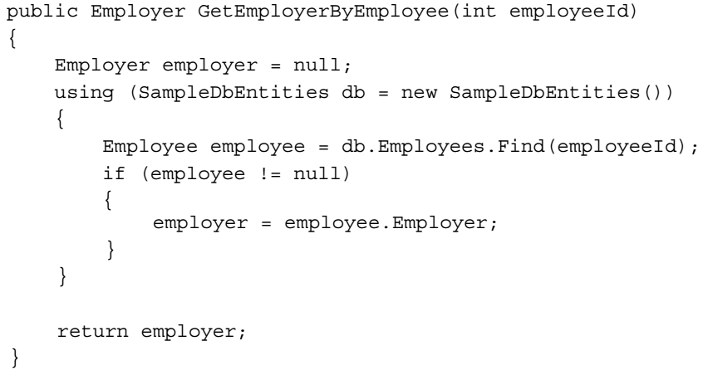
Listing R1

Slide 91
Retrieving a list of items
Let's start by looking at how we can use the entity at the one end of the relationship and retrieve the list of all the related entities at the many end.
From our sample application's perspective, we will see how we can retrieve a list of employees if we have the employer object.
This can be achieved by using the navigation property, Employees, available in the Employer object.
Let's see how this can be done in code: Listing R2.
In the preceding code, we create the DbContext object and using this object, we fetch the Employer by the given employerId function.
If we find an Employer object with this ID, we retrieve the Employees associated with it. Internally, Entity Framework is generating a SQL to fetch all the employees associated with this employerid and return all the records as a collection of Employee entities.
NOTE: If the requirement was to find a particular Employee instead of the list, we can further query the Employee list retrieved.

Slide 92
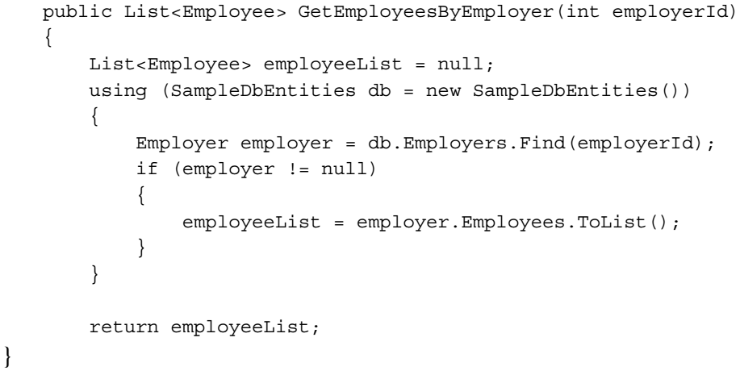
Listing R2

Slide 93
Adding an item

Slide 95
Updating an item

Slide 96
Deleting an item

Slide 97
Entity Framework – behind the scenes
If we have the entity at the many end of the application and we want to retrieve the entity at the one end, we can use the navigation property to do this.
From our sample application's perspective, we will see how we can retrieve the employer for a given employee.
This can be achieved by using the Employer navigation property, available in the Employer object.
Let's see how this can be done in code:

Slide 98
3
Entity Framework DB First – Performing Model Validations

Slide 99
4
EF DB First – Inheritance Relationships between Entities

Slide 100
5
EF DB First – Using Views, Stored Procedures, and Functions

Slide 101
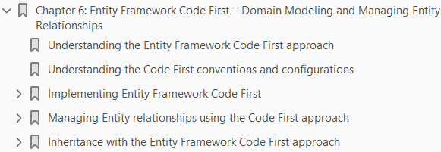
6
EF Code First – Domain Modeling & Managing Entity Relationships

Slide 102
Intro
We can use Entity Framework with an existing database using the Entity Framework Database First approach.
The other end of the spectrum is to see how we can design our application domain models in such a way that we can use Entity Framework to persist the domain entity's data in the database.
This can be done using the Entity Framework Code First approach.

Slide 103
Note
The same can also be achieved using the Entity Framework Model First approach.
The only difference in the Model First approach is that we will be using Visual Entity Designer instead of writing our entity Plain Old CLR Objects (POCOs) classes ourselves.
Conceptually, both these approaches will be similar.

Slide 104
Understanding the EF Code First approach
Traditionally, we have designed an application using a bottom-up approach, that is, we used to think about the database first and then used this data-centric approach to build our application on top of it.
This approach is still very useful for the applications that are data intensive, or perhaps the database also contains some business logic that is being used by multiple applications.
For such applications, if we want to use Entity Framework, we have to use the Database First approach.
Another way (or rather the modern way) of designing applications is using the domain-centric approach (Domain Driven Design).
Domain Driven Design is more of a top-down approach, where we start designing our application by thinking in terms of the domain models and entities that are needed to realize our application.
The database is merely used for persistence of this model data.
Using Domain Driven Design would mean that we design our models and entities as per our application needs, and they are persistent ignorant, that is, they can be saved using any database technology.
In such scenarios, we should use the Entity Framework Code First approach, as this lets us create POCOs for our domain models that are persistence ignorant.
Entity Framework will take care of storing the entities data in any database.

Slide 105
Benefits of EF Code First Approach
Here are a few benefits of using the Entity Framework Code First approach:
It supports Domain Driven Design
We can start developing our application early, as we don't have to wait for the database to be created
The persistence layer, that is, the underlying database can be changed without having any impact on the models

Slide 106
Understanding the Code First conventions and Configurations
The first thing that we need to understand is the concept of convention over configuration.
The Code First approach expects the model classes to follow some conventions, so that the database persistence logic can be extracted from the model.
For example, if we define a property named ID in the model class, this property value will be treated as the primary key for the table that is being mapped to this class.
The benefit of this convention-based approach is that if we are following the conventions, then we don't have to write any extra code to manage the database persistence logic.
The downside of this approach is that if a convention is not followed, and Entity Framework is not able to extract the needed information from the model, an exception will be thrown at runtime.
In scenarios where we are not able to follow the conventions but still need Entity Framework to persist the data, we need to provide some additional information with our model using the Code First configuration options, so that Entity Framework is able to extract all the needed information from our model.
For example, if we cannot have a property named ID in our model as the primary key, we need to update the desired property with the [Key] attribute and that will be taken as the primary key.
Entity Framework uses these conventions to create table names by pluralizing the class' name, and it creates the columns with the same names as the class' properties.

Slide 107
Implementing Entity Framework Code First
Consider a small application with a POCO for an employee, and see how we can use Entity Framework to perform CRUD operations on this model:
Create the Employee model (Figure 6-1)– By Convection, the generated table name will be Employees, the column names will be the name of the properties, and the ID field will be treated as the primary key.
If we want to override these default convention-based values and provide our values, then we can do this by updating the class and properties with the needed attributes.
Now, let’s create the DbContext class to perform CRUD operations on this model.
We need to define our DbContext class by inheriting from the DbContext class. This context class should contain DbSet<Employee>, so that it is able to perform CRUD operations on the Employee model:

Slide 108
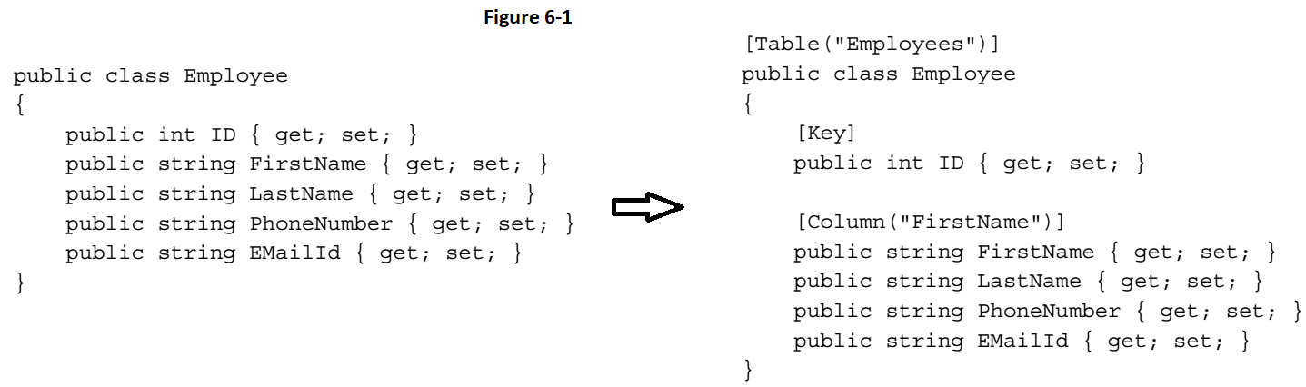
Figure 6-1

Slide 109
Managing Entity relationships using the Code First approach

Slide 110
Inheritance with the Entity Framework Code First approach

Slide 111
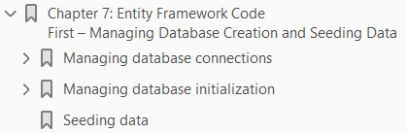
7
EF Code First – Managing Database Creation & Seeding Data

Slide 112
Intro
So far, we have seen how we can use various Entity Framework approaches.
We have seen the details of the Database First approach, and how we can use Entity Framework's Code First approach to create the database from our domain entities.
Now, let's see how we can use Entity Framework to manage database creation.
We will take a look at how we can specify the location and name of the database.
We will also see how we can initialize the database using Entity Framework's provided mechanism.
Finally, we will take a look at how we can seed the database with some initial data using Entity Framework.

Slide 113
Managing database connections
The first thing that comes to mind when we use Entity Framework code first is how we will manage the various connection parameters.
In this section, we will see how we can manage the various connection parameters such as database location and database name.

Slide 114
Managing connections using a configuration file

Slide 115
Using an existing ConnectionString

Slide 116
Using an existing connection

Slide 117
Managing database initialization
When we run our Entity Framework Code First application for the first time, Entity Framework will do the following:
Check the DbContext class that is being used.
Find the connectionString that should be used with this context class.
Find the domain entities and extract the schema-related information.
The database will be created.
Data will be inserted into the system.
What will happen if the database already exists? What will happen if the application is run a second time? Should it create the database again or simply use the existing database?
These are a few questions that can be answered simply by understanding the database initialization process of Entity Framework.
Once the schema information is extracted, Entity Framework will use database initializers to push the schema information to the database.
There are various possible strategies for database initializers, and Entity Framework's default strategy is to
create the database if it doesn't exist, and
use the existing one if it exists.

Slide 118
Database initialization strategies
The possible database initialization strategies are as follows:
CreateDatabaseIfNotExists: This will create the database if it does not exist, and if it exists, then it will use the existing database. If there is a mismatch in the schema information extracted from the domain models and the actual database schema, an exception will be thrown.
DropCreateDatabaseAlways: If this strategy is used, the database is dropped every time the application is run.
This is mostly useful in the early stages of the development cycle when we usually design our domain entities. It is also useful from a unit tests perspective.
DropCreateDatabaseIfModelChanges: If this strategy is used, it will create the database if it does not exist, and if it exists, then it will use the existing database. However, the important thing to note here is that if there is a mismatch in the schema information extracted from the domain models and the actual database schema, the database will be dropped and created again.
MigrateDatabaseToLatestVersion: If we use this initializer, then Entity Framework will automatically update the database schema whenever our entity model is updated. The important part to note here is that it will update the schema without losing the data or update the already existing database objects in the existing database.

Slide 119
Setting the initialization strategy
By default, Entity Framework uses CreateDatabaseIfNotExists as the default initializer.
To override the default database initialization strategy, we need to use the Database.SetInitializer method in the constructor of our DbContext class.
Let's see how this can be done to use the DropCreateDatabaseIfModelChanges strategy rather than the default strategy – Figure 7-7.
In the preceding code, whenever the object of our context class is created, the Database.SetInitializer method will be called, and it will set the database initialization strategy to DropCreateDatabaseIfModelChanges.

Slide 120

Figure 7-7

Slide 121

Note
The MigrateDatabaseToLatestVersion initializer is available only from Entity Framework version 4.3 onwards.
If we are in the production environment, then we don't want to lose the existing data by mistake.
It is also possible to turn off the initializers.
We just need to pass null to the Database.SetInitializer method.
The following code shows how this can be done:

Slide 122
Seeding data
So far, we have seen how we can take control over the location of the database and name of the database and how we can set the database initialization strategy.
One thing to note here is that the database that will be created by Entity Framework will always be an empty database irrespective of the strategy we chose to initialize the database.
There are many scenarios where we might want to have some values inserted in the database once it is created but before it is used.
Master tables and lookup tables are such examples.
Also, in some cases, the application deployment wants the data for the administrators to be populated with their default credentials.
Or perhaps we want some dummy data in our tables to test how our application behaves in a specific scenario.
Seeding data is very important when we are using the DropCreateDatabaseAlways or DropCreateDatabaseIfModelChanges initialization strategies, since every time we run the application, the database will be recreated (in the latter case, every time the model is changed), and manually inserting the data in the tables after each database creation will become very tedious.
Let's see how we can use Entity Framework to insert/seed dummy data after the database has been created.

Slide 123
Seeding Data - Procedure
To seed some initial data in the database, we need to create our own database initializer class that will:
Derive data from the existing database initializer class
Seed the database during creation
Let's say we want to use the DropCreateDatabaseAlways strategy in our application.
We have a model, Employer, defined in our code as shown in Figure 7-8.
We also have our DbContext class created to use this model with the Entity Framework Code First approach Figure 7-8.
Now we want to seed some data each time a database is created.
The first thing we need to do is to create our own database initialization class, which should be derived from the DropCreateDatabaseAlways class (Figure 7-9).
Next, we need to seed the data using this initializer class by overriding the Seed method of the DropCreateDatabaseAlways class (Figure 7-10).
In the preceding code, we are overriding the Seed method of the DropCreateDatabaseAlways class.

Slide 124
Seeding Data – Procedure |
This method has access to the DbContext class, and it can use this DbContext class to insert some data in the database (Figure 7-11).
What the preceding code is doing is creating the Employer objects and adding them to the Employers collection of the DbContext class.
One important thing to note in this code is that we are not calling DbContext.SaveChanges( ) because it will automatically be called in the base class.
Now let's use this initializer with our context class:

Slide 125


Figure 7-8 || 7-9

Slide 126

Figure 7-10

Slide 127

Figure 7-11

Slide 128

8
Querying the Entity Data Model – LINQ to Entities

Slide 129
Intro
So far, we have seen how we can create the Entity Data Model using the Database First approach and Code First approach of Entity Framework.
We also looked at
domain modeling
performing model validations
taking control of the database connection parameters using Entity Framework
Once we have all the domain modeling done, we would want to query the object model.
There are two ways in which we can query the Entity Data Model:
LINQ to Entities
Entity SQL
In this chapter, we will discuss how we can query the Entity Data Model using LINQ to Entities.

Slide 130
Understanding LINQ to Entities
Language-Integrated Query (LINQ) is a technique for querying data from .NET languages.
LINQ to Entities is the mechanism that facilitates the use of LINQ to write queries against our conceptual model such as the Entity Data Model.
Since LINQ is a declarative language, let's focus on what data we need rather than how it should be retrieved.
LINQ to Entities provides a nice abstraction over the Entity Data Model so that we can use LINQ to specify what data should be retrieved, and the LINQ to Entities provider will take care of accessing the database and fetching the required data for us.
When we use LINQ to Entities to execute the LINQ queries against the Entity Data Model, these LINQ queries are first compiled to determine what data we want to fetch.
It will then be executed and from the application's perspective, the results will be returned as CLR objects, that is, something that .NET understands, Figure 8-1A.
However, if we want to understand the complete process, it's crucial to understand how these queries are being executed and retrieving the results back as .NET objects.
In the preceding diagram, let's visualize how LINQ to Entities fits in the overall architecture, and how our LINQ queries get executed using Entity Framework.

Slide 131

Figure 8-1A

Slide 132
Architecture
The diagram Figure 8-1A shows that LINQ to Entities relies on EntityClient to be able to work with the Entity Framework conceptual data model.
Let's see how LINQ to SQL executes the query and returns the result to the application:
The application creates a LINQ query.
LINQ to Entities will transform our LINQ queries to the EntityClient commands.
The EntityClient command will then use Entity Framework and the Entity Data Model to translate these commands into the SQL query.
The SQL query will then be passed to the database using the underlying ADO.NET provider.
The query will be executed on the database.
The result will be returned to the Entity Framework.
Entity Framework will convert the result back to CLR types such as domain entities.
EntityClient will use projects and return the required results to the application.
If we want to use LINQ to Entities with multiple types of database, we just need to use the proper ADO.NET provider for the database, and EntityClient will be able to use this making our LINQ queries work seamlessly against any database.

Slide 133
EntityClient Object
The EntityClient object resides in the System.Data.EntityClient namespace.
We don't have to create this object explicitly.
We just need to use this namespace and LINQ to Entities will take care of the rest.

Slide 134
Querying data using LINQ to Entities
Now that we know how LINQ to Entities works internally, let's take a look at how we can query the Entity Data Model using LINQ.
There are two ways in which we can write LINQ queries:
The query syntax
The method syntax
Choosing between these two approaches is purely a developer's choice.
Performance wise both are the same.
The query syntax is comparatively easy to understand but offers less flexibility.
The method syntax, on the contrary, is a little difficult to understand but offers great flexibility.
It is possible to chain multiple queries using the method syntax and thus achieve maximum results in a single statement.

Slide 135
Using LINQ to Entities – an example-based approach

Slide 136
Lazy loading and eager loading

Slide 137

9
Querying the Object Model – Entity SQL

Slide 138
10
Managing Concurrency Using Entity Framework

Slide 139
11
Managing Transactions Using Entity Framework

Slide 140
12
Implementing a Small Blogging Platform Using Entity Framework

Slide 141
EF Version History
C# Version History
Visual Studio Version History
Expression Tree
Domain Model Structure

Slide 142
EF Version History
The first two versions of Entity Framework shipped with the .NET Framework and had versions numbers that aligned with the version of the framework that they were included in (3.5 and 4).
After this EF started shipping independently and adopted the http://semver.org standard for semantic versioning.
Here is a summary of the Entity Framework releases and the features they added.
This table includes all the fully supported releases of Entity Framework and the latest pre-release version

Slide 143

EF 6.1.2 || 6.1.1

Slide 144

EF 6.1

Slide 145

EF 6.0.2 || 6.0.1

Slide 146

EF 6

Slide 147

EF 6 I

Slide 148

EF 5

Slide 149

EF 4.3.1 || 4.3 || 4.2 || 4.1.1 || 4.1

Slide 150

EF 4 || 3.5

Slide 151

C# Version History

Slide 152

Visual Studio Version History

Slide 153
Expression Tree
An expression tree is an efficient data representation, in tree form, of a query operator’s lambda expression.
These expression tree data representations can be evaluated, all simultaneously, so that a single query can be built and executed against a data source, such as a database.
Consider the code in Listing A1.
This query contains two operators, Where and OrderBy, that are expecting method delegates as their arguments.
When this code is compiled, .NET intermediate language (IL) code is emitted that is identical to an anonymous method for each of the query operator’s lambda expressions.
This linear execution of the operators seems reasonable for this example, but you should consider a query against a very large data source, such as a database.
Would it make sense for a SQL query to first call the database with the where statement only to turn around and order it in a subsequent call?
Of course this just isn’t feasible for database queries, as well as potentially other types of queries.
This is where expression trees become necessary.
Since an expression tree allows the simultaneous evaluation and execution of all operators in a query, a single query can be made instead of a separate query for each operator.

Slide 154



Listing A1|| A2 || A3

Slide 155
IL Code or Expression Tree
So there now are two different things the compiler can generate for an operator’s lambda expression,
IL code
Expression tree
What determines whether an operator’s lambda expression gets compiled into IL code or an expression tree?
The operator’s prototype will define which of these actions the compiler will take.
If the operator is declared to accept a method delegate, IL code will be emitted.
If the operator is declared to accept an expression of a method delegate, an expression tree is emitted.
As an example, let’s look at two different implementations of the Where operator.
The first is the Standard Query Operator that exists in the LINQ to Objects API, which is defined in the System.Linq.Enumerable class – Listing A2.
The second Where operator implementation exists in the LINQ to SQL API and is in the System.Linq.Queryable class – Listing A3.

Slide 156
IL Code or Expression Tree |
The first Where operator is declared to accept a method delegate, as specified by the Func delegate, and the compiler will generate IL code for this operator’s lambda expression.
The second Where operator is declared to accept an expression tree (Expression), so the compiler will generate an expression tree data representation of the lambda expression.
The operators that accept an IEnumerable<T> sequence as their first argument are declared to accept a method delegate for their lambda expressions.
The operators that accept an IQueryable<T> sequence as their first argument are declared to accept an expression tree.

Slide 157
Domain Model Structure
In the study of ORM, one has to understand the architectural structure of an efficient domain model.
As Eric Evans points out in his popular book Domain- Driven Design (Addison-Wesley Professional, 2003), the domain model can be broken into the following pieces:
Entities
Value objects
Services
Aggregates
Factories
Repositories

